Slide 1


Registered Disability Savings Plan, Canada Disability Savings Grant and Canada Disability Savings Bond
Des renseignements en français
sont disponibles sur demande

Slide 2
Contents
Part I: About the Registered Disability Savings Plan (RDSP), Grant and Bond
Part II: Opening an RDSP
Part III: Benefits & Contributions
Part IV: Withdrawing money from an RDSP
Part V: Closure of an RDSP

Slide 3
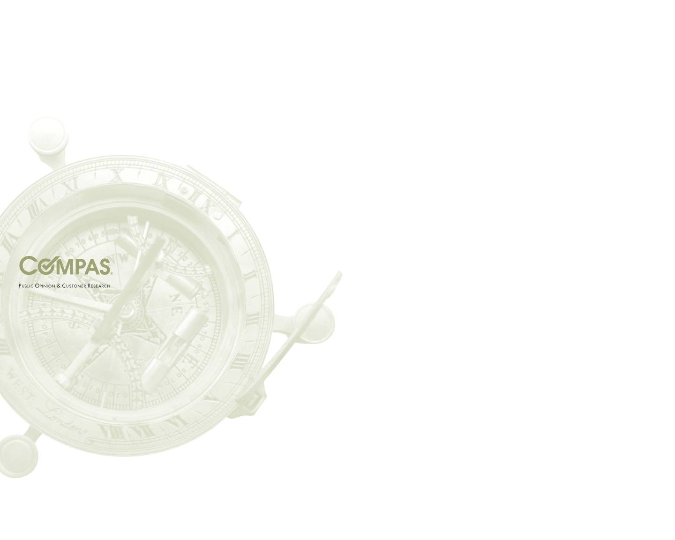
Part I: About the Registered Disability Savings Plan (RDSP), Grant and Bond

Slide 4
What is the RDSP?
A long-term savings plan to help Canadians with disabilities and their families save for the future.
To be eligible for the RDSP, individuals must be:
Under the age of 60;
A Canadian resident; and
Eligible for the Disability Tax Credit (Disability Amount).

Slide 5
What is the Disability Tax Credit (Disability Amount)?
A non-refundable credit that reduces the amount of income tax that an individual with a severe and prolonged physical or mental disability may have to pay.
For more information about the Disability Tax Credit (Disability Amount), visit the Canada Revenue Agency Web site www.cra-arc.gc.ca/disability or call 1-800-959-8281 (TTY users call 1-800-665-0354).

Slide 6
Who is Eligible for the Disability Tax Credit (Disability Amount)?
A qualified practitioner must certify that an individual has ‘an impairment in mental or physical functions which is both severe and prolonged’, with effects in one of these categories:
Vision;
Marked restriction in a basic activity of daily living;
Life-sustaining therapy; or
The cumulative effect of significant restrictions.

Slide 7
The RDSP has Two Components
The Canadian Disability Savings Bond
The Canadian Disability Savings Grant

Slide 8
What is the Canada Disability Savings Bond?
The Government will deposit a bond of up to $1,000 a year into the RDSPs of low-income and modest-income Canadians, even if no contribution is made.
There is a lifetime limit of $20,000.
Bonds will be paid into an RDSP until the year the beneficiary turns 49 years old.

Slide 9
Receiving the Bond
Beneficiary’s family income | Bond
Less than $ 24,183* (or if the holder is a public institution) | $1,000
Between $24,183* and $41,544 | Part of the $1,000 based on the formula in the Canada Disability Savings Act
More than $41,544 * | No bond is paid
*The beneficiary family income thresholds are indexed each year to inflation. The income thresholds shown are for 2011.

Slide 10
What is the Canada Disability Savings Grant?
The Government will pay a matching grant of up to 300%, depending on the amount contributed to the RDSP, and the beneficiary’s family income.
A maximum of $3,500 will be paid each year, with a lifetime limit of $70,000.
Grants will be paid into an RDSP until the year the beneficiary turns 49 years old.

Slide 11
Receiving the Grant
Beneficiary’s family income | Grant | Maximum
$83,088* or less
On the first $500 contributed | $3 for every $1 contributed | $1,500
On the next $1,000 contributed | $2 for every $1 contributed | $2,000
More than $83,088*
On the first $1,000 contributed | $1 for every $1 contributed | $1,000
*The beneficiary family income thresholds are indexed each year to inflation. The income thresholds shown are for 2011.

Slide 12
Family Income
The amount of grant and/or bond for which a beneficiary qualifies is dependent on family income:
Until the beneficiary turns 18 years of age, family income is based on the income information that was used to determine the Canada Child Tax Benefit for that beneficiary.
Beginning the year the beneficiary turns 19 years of age, family income is based on his or her own income (with that of his or her spouse).

Slide 13
Part II: How to Open an RDSP

Slide 14
Steps to Opening an RDSP
Identify the Beneficiary
Identify the Policy Holder
Ensure Social Insurance Number
Ensure you are eligible for the Disability Tax Credit
Contact a participating financial organization
Complete an RDSP application form
Complete a grant or bond application form

Slide 15
Identify the beneficiary
This is the person who will receive the money in the future. They must:
Be under the age of 60;
Be a Canadian resident;
Be eligible for the Disability Tax Credit (Disability Amount); and
Have a social insurance number.

Slide 16
Identify the holder
This is the person who can open and manage the RDSP:
If the beneficiary is under the age of majority, the holder can be a legal parent, legal representative or public department.
If the beneficiary is over the age of majority, the holder can be a beneficiary, guardian, legal representative, or public department.

Slide 17
Contact a participating financial organization
To open an RDSP:
An RDSP can be opened by completing a registration form at a participating financial institution.
The bank will require the beneficiary’s social insurance number.
To apply for the grant and bond:
Upon opening an RDSP, apply for the grant and/or bond by completing an application form.

Slide 18





Financial Organizations which offer the RDSP
BMO Bank of Montreal
1-800-665-7700
TTY: 1-866-889-0889
CIBC
1-800-465-3863
TTY: 1-800-465-7401
DESJARDINS
1-877-286-3420
RBC Royal Bank
1-800-463-3863
TTY: 1-800-661-1275
TD Waterhouse Canada Inc.
1-866-280-2022
TTY: 1-800-361-1180
Bank of Nova Scotia
1-877-929-4499
TTY: 1-800-645-0288
Les Fonds d'investissement FMOQ inc. offers the RDSP, grant and bond to residents in Quebec. For more information, visit the Fonds d'investissements FMOQ inc. Web site. (In French only)

Slide 19
Part III: Benefits and
Contributions

Slide 20
Making contributions to an RDSP
Who can contribute?
The holder; and/or
Anyone with written permission from the holder, e.g. a family member or friend.
There is no annual contribution limit, but there is a lifetime contribution limit of $200,000.
Contributions are permitted until the end of the year in which the beneficiary turns 59 years of age.

Slide 21
The Impact of the RDSP in terms of benefits
Money paid out of an RDSP will not affect eligibility for federal benefits such as the Canada Child Tax Benefit, the Goods and Services Tax Credit, Old Age Security and Employment Insurance Benefits or PWD Benefit (income support).
All provinces and territories have announced a partial or full exemption of RDSP income and assets for the purposes of assessing eligibility for provincial and territorial programs and services. The PWD Benefit is fully exempt
Contributions to an RDSP are not tax-deductible, and will not be included in income when paid out of an RDSP.

Slide 22
Part IV: Withdrawing Money from an RDSP

Slide 23
Types of withdrawals from an RDSP
Disability Assistance Payment (DAP):
A withdrawal from the RDSP to the beneficiary.
Lifetime Disability Assistance Payment (LDAP):
Regular withdrawals that must begin by the age 60 (but may begin earlier).
Once started, LDAPs must continue to be paid at least annually until the beneficiary passes away or the plan is closed.

Slide 24
Summary: RDSP is a long-term savings plan
Age 0 49 60 90⁺
Open RDSP
Building long-term savings
Receive Grants and Bonds
Receive payments
Assets in RDSP

Slide 25
Part V: Closure of an RDSP

Slide 26
RDSP closure
Grants and bonds that have been in the RDSP for less than 10 years must be repaid to the government if:
The plan is closed;
The beneficiary loses their eligibility for the Disability Tax Credit (Disability Amount); or
The beneficiary passes away.

Slide 27
Contact information for Canadians
Grant and Bond:
Call: 1 800 O-Canada (1-800-622-6232)
TTY: 1-800-926-9105
Email: rdsp-reei@hrsdc-rhdsc.gc.ca
Web site: www.disabilitysavings.gc.ca
RDSP:
Call: 1-800-959-8281
TTY: 1-800-665-0354
Web site: www.cra.gc.ca

Slide 28
Questions? Need help to complete your Application?
COMPAS staff are available to answer your RDSP questions and help you complete your RDSP application
Call us at 1-877-287-7655
E-mail us at taylorq@compas.ca
Bell Relay Operator: 1-800-855-0511
TTY (Deaf, Deafened, Hard of Hearing): Dial 711
Website: www.compas.ca

Slide 29

Thank You

