Slide 1
Literacy

Slide 2
Start where the student is at
Using the comprehension assessments, observation, contextual assessment, etc. determine the student’s level of readiness.

Slide 3
Choosing vocabulary
Meaningful
Short phrases
Sound effects

Slide 4
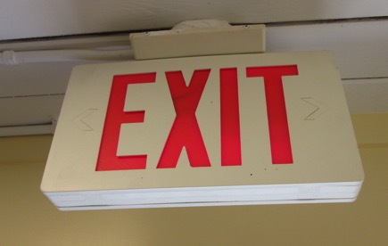
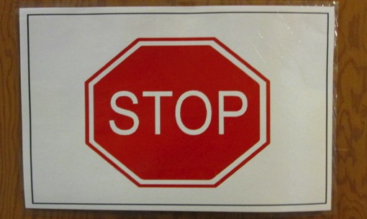
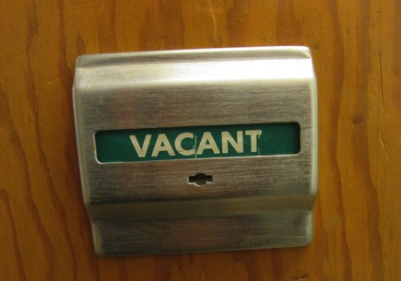
Functional literacy

Slide 5
Select a path
Functional?
Academic?

Slide 6
FAAB

Slide 7
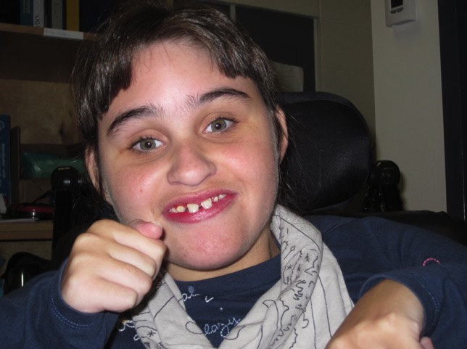
Lily Makes Lunch

Slide 8
Lily mixes up the meat and coleslaw. Mmmm, making Mom’s lunch.

Slide 9
The meat is all mixed. Mmmmm, making Mom’s lunch.

Slide 10
Next comes the tortilla. Mmmmm, making Mom’s lunch.

Slide 11
Lily puts the meat on the tortilla. Mmmm, making Mom’s lunch.

Slide 12
Pat it down. Mmmm, making Mom’s lunch.

Slide 13
Lily wraps it up. Mmmm, making Mom’s lunch.

Slide 14
It’s a wrap! Mmmm, Mom’s lunch!

Slide 15
Tar Heel Readers

Slide 16
Before I Read Levere, J. & Susut, C., sd61

Slide 17
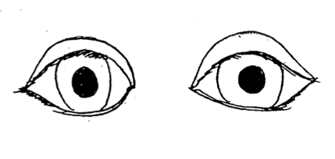
Look
At the title
At the cover
At the pictures

Slide 18
Think
What do I already know?
What does the title make me think of?
What does the cover make me think of?
What do the pictures make me think of?
Do I know what all of the pictures are about?

Slide 19
Think
What does the title make me think?
What does the cover make me think?
What do the pictures make me think?
Do I know what all of the pictures are about?

Slide 20
Predict
What do you think the story will tell you?
What might happen in this story?

Slide 21
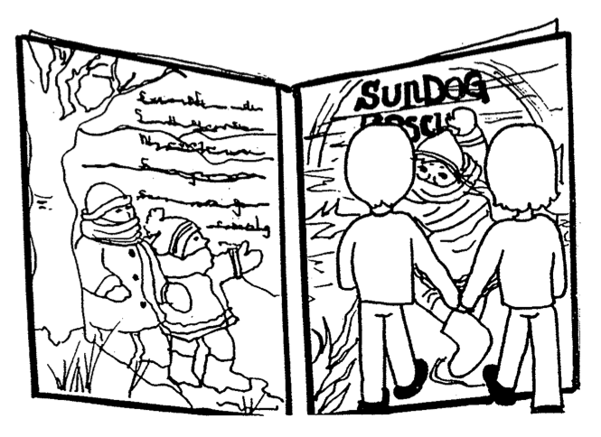
Take a Picture Walk
Look
Think
Predict

Slide 22
Pictello App

Slide 23
Numeracy

Slide 24
Early numeracy concepts
Understands concept of “more”: responds to question; makes request for “more” of pleasurable object/activity. LEVEL 3
Has concepts of one, two and all. LEVEL 4
Identifies adjectives: Big/little; small; Long/short; front/back; empty/full. LEVEL 5
Identifies shapes: circle, square, triangle. LEVEL 5
Makes predictions (Science). LEVEL 5
Counts 3 objects. LEVEL 5
Answers “how many” for number concepts. LEVEL 5
Understands number concepts up to 3. LEVEL 6
Identifies spatial concepts: between, above, below, top, bottom. LEVEL 6

Slide 25
Numeracy in Functional Routines
Cooking
Games
Shopping (grocery store list)
Dressing (pair of shoes, e.g., one, two)
Art (a big paint brush and a little paint brush)
Shapes (sit at the round table or the square table)

