Slide 1
TEACHING DEAF AND HARD OF HEARING STUDENTS
Hearing, Educational Implications
and
Strategies to make your Teaching Effective
Pam Guilbault
Linda Haynes
Itinerant Teachers for the Deaf and Hard of Hearing
S.D. #61(Victoria)
Notes:
Introduce self and fellow presenters.
Find out make up of audience.

Slide 2
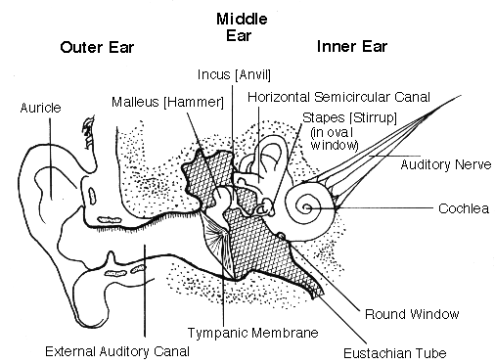
How the Ear Hears
Notes:
Outer ear: Hearing loss can occur through wax blockage or puncture of the eardrum.
Middle Ear: The three middle ear bones, which could all fit on your baby finger’s nail, amplify sound as they transmit it to the cochlea. It is connected to the nose cavity, where mucus backs up into the middle ear cavity when you have a cold, which simulates a conductive hearing loss
Conductive hearing loss is the name when the hearing loss occurs in the Outer or Middle regions. Usually surgery can repair the hearing loss.
Inner Ear: Snail-shaped structure, the Cochlea, contains fluid and tiny hair cells that are the receptors for sound. The hairs are triggered by particular frequencies of sound, send an electrical signal up the auditory nerve to the brain. The brain interprets the sound = makes sense of what the ear hears. Sensorineural hearing loss is the name for any loss that occurs in the Inner Ear. At this time, surgery cannot repair damage done to the hair cells. This type of hearing loss is permanent.
Auditory Processing Disorder: This is not an inability to hear the sound by the ear structure. This occurs in the brain, with the brain not registering the sounds.

Slide 3
125
250
500
1000
2000
4000
8000
0
10
20
z
v
f th
p
s
30
h
g
ch
40
j
mdb
l
sh
n
o
a
ng
r
50
e i
HEARING LEVEL (dB HL)
u
60
70
80
90
100
110
120
AUDIOGRAM OF FAMILIAR SOUNDS
FREQUENCY IN CYCLES PER SECOND (HZ)
Notes:
This is an example of an audiogram, the graph used for recording where an individual hears sounds. On this audiogram are examples of familiar sounds and where they would be placed on the audiogram. The speech sounds form a “Speech Banana”. It is important to note where different sounds are heard, as they play a difference in how we understand language. For example, the “s” sound is very important in English but not important in French.

Slide 4
125
250
500
1000
2000
4000
8000
LOW PITCH
HIGH PITCH
FREQUENCY IN CYCLES PER SECOND (HZ)

Slide 5
SOFT
0
10
20
30
40
50
HEARING LEVEL (dB HL)
60
70
80
90
100
LOUD
110
120

Slide 6
125
250
500
1000
2000
4000
8000
0
10
20
30
40
50
HEARING LEVEL (dB HL)
60
70
80
90
100
110
120
AUDIOGRAM OF FAMILIAR SOUNDS
FREQUENCY IN CYCLES PER SECOND (HZ)

Slide 7
125
250
500
1000
2000
4000
8000
0
10
20
30
40
50
HEARING LEVEL (dB HL)
60
70
80
90
100
110
120
AUDIOGRAM OF FAMILIAR SOUNDS
FREQUENCY IN CYCLES PER SECOND (HZ)

Slide 8
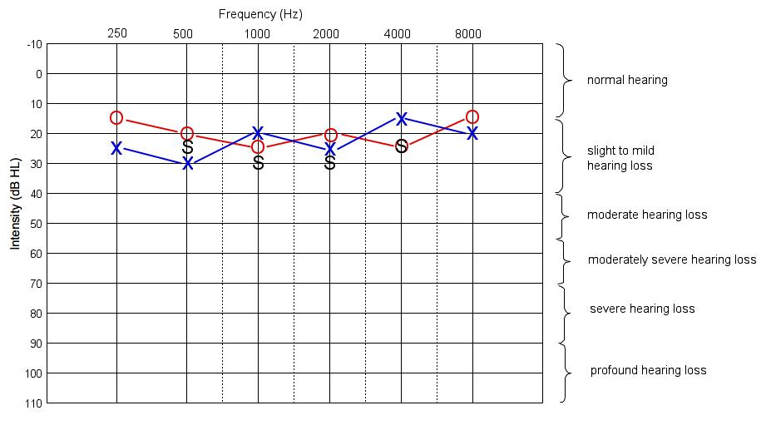
Sample Audiograms
The Xs are the responses for the left ear.
The Os are the responses for the right ear.
The Ss are the responses through the speakers (this provides information about how well your child hears when listening with both ears, or about the better hearing ear, if the ears don’t hear the same)
Notes:
Categories of hearing loss by severity:
Slight hearing loss is defined as hearing thresholds in the range 20 to 25 dB.
Mild hearing loss is defined as hearing thresholds in the range 26 to 40 dB.
Moderate hearing loss is defined as hearing thresholds in the range of 40-55 dB.
Moderately-severe hearing loss is defined as hearing thresholds in the range of 56-70 dB.
Severe hearing loss is defined as hearing thresholds in the range of 71-90 dB.
Profound hearing loss is defined as hearing thresholds above 90 dB.

Slide 9
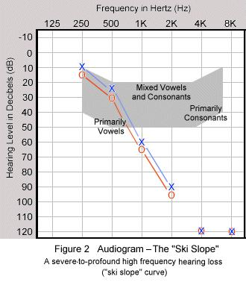
Notes:
Without hearing aids, this student would only receive vowel sounds.
Vowel sounds give the rhythm and pitch to speech (was a statement or question said) but consonants give the intelligibility of speech (what someone said).
Eg. _a_ _ a_ _ _ i_ _ _e_ _ u_ _ _ e _i_ _.
J_ck _nd J_ll w_nt _p th_ h_ll.
You can figure out what the second sentence says but you can’t figure out the first sentence. You need consonant sounds to make sense of speech.

Slide 10
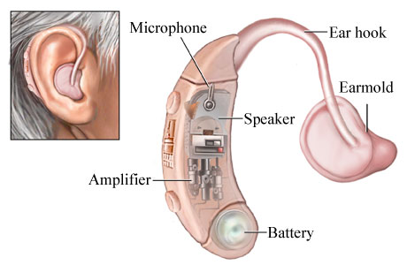
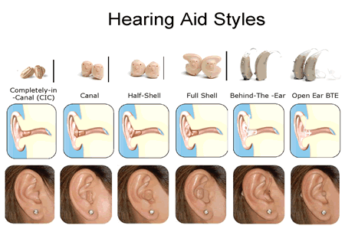
Hearing Aid Equipment
Notes:
Hearing aids come in a variety of sizes, styles and colours. Usually, for young children, they will be wearing hearing aids that fit behind the back of their ears, called BTE. Sometimes students will ask for ‘In the Ear’ style when they get older. You’ll see many adults wearing both styles. Decisions on styles depend on whether the aid can be made powerful enough, and whether the external ear (the pinna) is finished growing.
Earmolds also come in a variety of forms. As a child grows their ear grows, too. So earmolds often have to be made anew every 6 months.

Slide 11
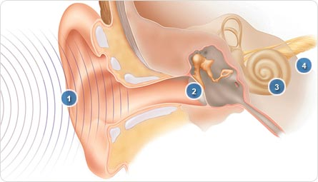
Refresher on How the Ear Hears
1. Ear canal: Sound moves through the ear canal and strikes the eardrum.
2. Eardrum and bones: Sound waves cause the eardrum to vibrate, sending the bones in the middle ear into motion.
3. Inner ear: This motion causes the fluid inside the inner ear (cochlea) to move the hair cells.
4. Hearing nerve: Hair cells change the movement into electric impulses, which are sent to the hearing nerve into the brain; you hear sound.

Slide 12
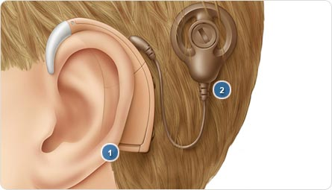
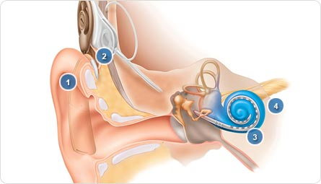
Cochlear Implants
1. Freedom BTE sound processor
2. Cable and Coil
1. Sound processor: External sound processor captures sound and converts it into digital signals.
2. Digital signals: Processor sends digital signals to internal implant.
3. Electrode array: Internal implant converts signals into electrical energy, sending it to an electrode array inside the cochlea.
4. Hearing nerve: Electrodes stimulate hearing nerve, bypassing damaged hair cells, and the brain perceives signals as sound.

Slide 13
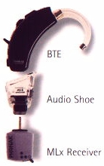
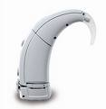
FM Equipment
Receivers:
Transmitters and microphones:
Notes:
In classrooms, the noise to speech ratio can make it difficult for a student to be able to ‘zone in’ on the teacher’s voice. FM technology, the same as used on radios to broadcast music, is used between the student and teacher. In essence, a radio station is set-up between the two and wherever the teacher goes, their voice is equally loud in the student’s ear.
The student wears a receiver on their hearing aid while the teacher wears a transmitter with a microphone. The microphones can be imbedded in the transmitter or be a separate lapel or boom-style microphone.

Slide 14
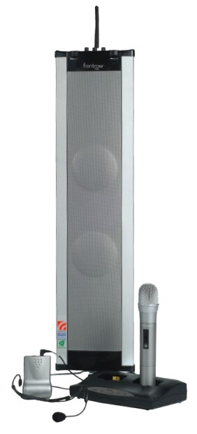
FM Equipment Continued
A soundfield system in a regular classroom
will give benefit to all the students.
Systems can broadcast on FM radio waves or on
Infrared waves.
Notes:
School Districts are starting to recognize the benefits of soundfield systems for all students. Some districts are installing these systems in all their kindergarten to grade 3 classrooms. A student who uses personal FM equipment can have their equipment connected to the soundfield system, so that the teacher only has to wear one microphone.

Slide 15
EDUCATIONAL IMPLICATIONS
Difficult to hear in background noise therefore:
1. May not hear directions for homework or assignments
2. May miss or misinterpret orally presented information
Notes:
Strategies:
Write homework assignments on the board, in the same location.
Provide as many visuals as you can to support your information. E.g. maps; write new and important (testable) vocabulary on the board; provide written copy of your notes to the student;

Slide 16
EDUCATIONAL IMPLICATIONS CON’T
Difficulty participating in group work and class discussions:
1. Locating the speaker is difficult.
2. What was said or asked?
Fatigue from listening intently all day:
1. Combining hearing, lip-reading and ‘educated’ guesses.
Notes:
Strategies:
Pronounce the speaker’s name while pointing your body, head or arm in their direction.
Reiterate/rephrase the comment or question.
They often get only 50% of their information from hearing. Combining lip-reading and guesses helps to fill in the gaps but this means the student must have good background knowledge. This isn’t always the case when you are teaching something new.

Slide 17
CLASSROOM COMMUNICATION
Get the student’s attention before speaking
Do not talk to the blackboard
Do not stand in front of the windows when talking
Use an overhead projector, correctly
Minimize background noise (fans, chatter)
Use closed captioning on videos
Repeat P.A. announcements
Notes:
Be aware of “backlighting”, when your face is in darkness because you are standing in front of a light source.
Find out how to turn on the captioning on your TVs
Select “CC” (closed captioned) versions of videos - everyone benefits
Write P.A. announcements on the board

Slide 18
STUDENT’S RESPONSIBILITIES
Wear their hearing aids
Choose appropriate seating locations
Tell the teacher if they are having difficulty hearing
Ask for clarification if they don’t understand instructions or vocabulary
Ask the teacher what is the homework
Notes:
These responsibilities develop as the student ages. You should expect a kindergarten child to wear their hearing aids, but not be aware of good seating locations. For older students, front and center for seating is not always the best. Usually back 2 rows and center works well as it allows the student to see who is answering questions and be more central to students’ answers.
Watch for the quizzical face or the ‘head nod’.

Slide 19
INTERPRETER’S RESPONSIBILITIES
Accurately interpret instructional information
Convey other students’ questions/replies
Stay in the role of interpreter
Prepare for new vocabulary/concepts
Give feedback about the interpreting process
Notes:
Subtleties and nuances should be conveyed as the speaker expressed them.
2. Uses the language levels of the students – no editing
3. Don’t speak to the interpreter, as if to include them in the conversation.
4. Give the interpreter any up and coming material to review prior to class.
5. Communicate with the interpreter about how the process is going – your comfort zone.

Slide 20
The Interpreter does not:
Discipline the student(s)
Keep the student on task
Assist with the assignments
Censor what is spoken
Act as a communication link with the parent
Take responsibility for the student’s classroom performance or absences
Notes:
An interpreter’s role is unique and not the same as an Educational Assistant. (Every district seems to have a different name for an adult whose job is to assist a teacher, usually with a special needs student.) For deaf students, an interpreter is there to provide the ‘translation’ into the language the student uses for communication. This can be sign language or it can be oral interpreting.

Slide 21
I SENSORI-NEURAL LOSS -
Occurs when there is a problem in the inner ear or with the neural pathway that carries sound to the brain. This type of loss is permanent and more severe than other types of loss.
CAUSES:
diseases during pregnancy
heredity
childhood diseases (mumps, measles, chicken pox)
viral infections (meningitis, encephalitis)
prolonged high fever
physical damage to head or ear
exposure to excessive or intense noise (loud music, gunfire, etc.)
This type of loss can generally be helped with a hearing aid or a cochlear implant, but these devices do not restore normal hearing. Persons using these devices often need auditory training.

Slide 22
II CONDUCTIVE LOSS -
Occurs when there is a problem in the outer or middle ear. This type of loss can usually be reduced or eliminated through medical and/or surgical treatment.
CAUSES:
infections that fill the middle ear with fluid
ruptured ear drum
interference (such as a build-up of ear wax)
deformity in the ear structures
damage caused by a foreign object (i.e. a pencil, stick, hairpin, bean)
missing or occluded (obstructed) ear canal
allergies
It must be remembered, however, that in young children periods of congestion caused by middle ear infections can result in delays in language and speech acquisition.

Slide 23
POSSIBLE SOCIAL AND EMOTIONAL
IMPLICATIONS OF HEARING LOSS
Students with hearing loss in the regular classroom may exhibit one or more of the following traits.
1. Hesitant to speak.
2. Pretends to understand when he/she does not understand.
3. Does not ask questions to help his/her understanding.
4. Needs to watch other students to understand instructions.
5. Is not aware of what is happening or how to respond in social situations.
6. Does not understand why he/she is being disciplined.
7. Does not pick up social courtesies, graces or tact immediately.
8. Hides the fact that he/she has a hearing loss.
9. Resents wearing his/her hearing aid.

Slide 24
SUGGESTIONS FOR IN THE CLASSROOM:
1. Stand where the light will fall on your face -- this is much easier for speech reading. Avoid standing in front of a window or bright light.
2. Keep general noise level down in the classroom. If a hearing aid is worn, it makes everything louder.
3. Supplementary pictures and diagrams should be used whenever possible. Make the work interesting. Use all the visual aids possible. Using the closed captioning option found on all TV’s when showing video or watching television is particularly helpful.
4. Students with hearing loss should be placed, for each teaching session, so there is a face to face visibility of the teacher’s speech movements. Encourage the students to watch the teacher’s face when the teacher is talking.
5. Students with hearing loss cannot take notes while they watch the face of the teacher. It is suggested that a hearing student make copies of class notes to be issued to deaf and hard of hearing students.
6. Use an FM or Soundfield System whenever possible.

Slide 25
SUGGESTIONS FOR THE TEACHER:
1. Key words, expressions, phrases, new vocabulary and assignments should be written on the board as well as being explained orally.
2. Care should be taken not to talk with one’s face turned downward to read notes, or hidden by a book, or hands, or turned to the board.
3. Give opportunity for oral reports or presentations.
4. Avoid using a loud voice - talk in a natural manner. The louder the speaker talks, the more distorted the speech sounds become.
5. Do not exaggerate your lip movement.
6. Natural gestures, not exaggerated, supplement oral presentations.
7. Students with hearing loss should be spoken to in full sentences. Rephrase sentences no understood. Avoid using single words. Use original sentence later if possible.

Slide 26
UNDERSTANDING THE DEAF AND HARD OF HEARING STUDENT:
1. Because speech reading is fatiguing, students with hearing loss may have difficulty holding their attention for long periods.
2. Students, including deaf and hard of hearing, can learn to look attentive and appear to understand when they do not. Ask direct questions.
3. It is better, for understanding, for other persons to be in close proximity to the deaf and hard of hearing student.
4. Speak to the student and call his/her name for attention. Touching or tapping the arm should not be any more necessary than with other students.
5. Remind hearing students to speak in complete sentences, to enunciate clearly and to face in the direction of the student with hearing loss.
6. Students with hearing loss need to learn any “in” expressions or words used by hearing students.

