Slide 1
Literacy

Slide 2
Start where the student is at
Using the comprehension assessments, observation, contextual assessment, etc. determine the student’s level of readiness.

Slide 3
Choosing vocabulary
Meaningful
Short phrases
Sound effects

Slide 4
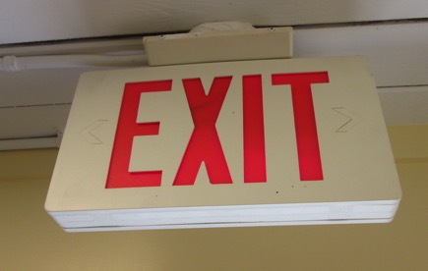
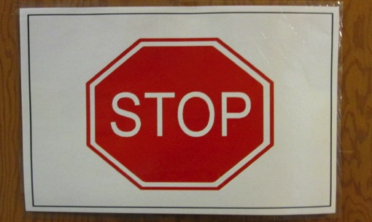
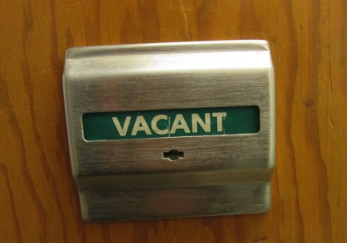
Functional literacy

Slide 5
FAAB - Functional Age-Appropriate Accessible Book

Slide 6
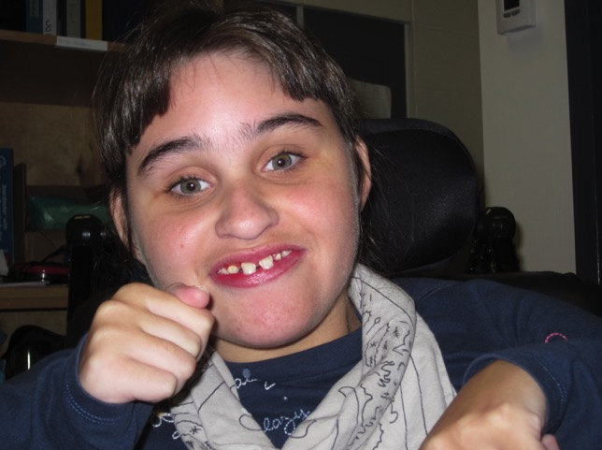
Lily Makes Lunch

Slide 7
Lily mixes up the meat and coleslaw. Mmmm, making Mom’s lunch.

Slide 8
The meat is all mixed. Mmmmm, making Mom’s lunch.

Slide 9
Next comes the tortilla. Mmmmm, making Mom’s lunch.

Slide 10
Lily puts the meat on the tortilla. Mmmm, making Mom’s lunch.

Slide 11
Pat it down. Mmmm, making Mom’s lunch.

Slide 12
Lily wraps it up. Mmmm, making Mom’s lunch.

Slide 13
It’s a wrap! Mmmm, Mom’s lunch!

Slide 14
Tar Heel Readers https://tarheelreader.org

Slide 15
Pictello
https://www.assistiveware.com/products/pictello

